Slide 1
IST 687
Group E Project
Angela Ozelski and Shaun McKellar

Slide 2
Table of contents
The Question
Summary of the Data Set
Most Common Cities in the Data Set
Linear Regression Analysis
Summary of Statistical Analysis

Slide 3
The Question:
What Variable Drives Housing Prices in India?

Slide 4
The Data set:
The House Price dataset provides valuable information about residential properties, encompassing a range of features such as carpet area, property status, floor, transaction type, furnishing, facing, overlooking, society name, bathroom count, balcony count, car parking availability, ownership type, super area, dimensions, plot area, property title, total amount, price per square foot, and a description of the property's location. This dataset offers insights into the dynamics of the housing market and can aid buyers, sellers, and real estate professionals in making informed decisions.

Slide 5

Most common cities in our data

Slide 6
Introduction on Variables
PRICE
BALCONY
Pricing is per square foot in Rupees. This is our dependent variable we are trying to predict.
This variable includes number of balconies in the property. Balconies are very important in Indian culture as it is a way of ventilation in the home and a way to socialize with neighbors.
CARPET AREA
India's real estate regulator RERA defines the carpet area of a property as the total area of all the rooms (including bedrooms, living rooms, and any other rooms) and toilets (What is Carpet Area vs Built-up Area vs Super Built-up Area?)
BATHROOM
This variable contains number of bathrooms in the home.
FURNISHING
These homes came either Furnished, Semi-Furnished, or Unfurnished. We converted this from a categorical variable to be 3-Furnished, 2-Semi-Furnished, or 1-Unfurnished.
LOCATION
These are cities in India. There are about 81 cities in our dataset (ex. Thane, Bangalore, Pune, etc)
Notes:
Once data was cleaned up, there were 16 variables. We decided to focus on these 5 independent variables.
Carpet area doesn’t include thickness of walls, balconies, and ducts

Slide 7
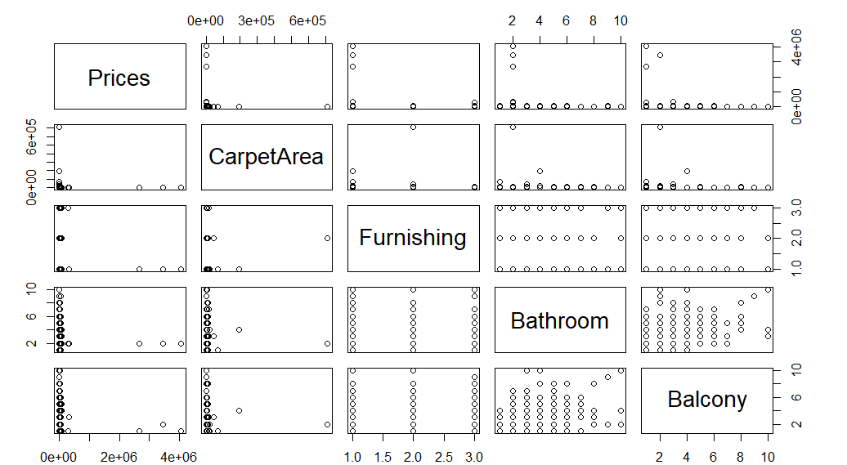
Plotting the data
SUMMARY
We have 59,892 observations in our cleaned-up data set. Below you can see it was difficult to find a relationship between variables of choice.

Slide 8
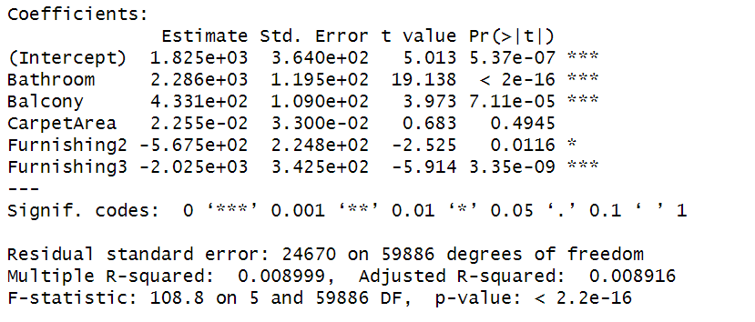
REGRESSION ANALYSIS for all cities price vs bathroom, balcony, carpet area, furnishing
LINEAR MODEL
Bathroom, Balcony, Carpet Area, Furnishing appears to be statistically significant but our R-Squared is very low.
Despite the R-Squared being statistically significant, a low R-Squared of .8% indicates this model is not strong in predicting Housing Pricing.
The coefficient of determination is weak. The overall fit of this model is poor. Only .8% of the observed variation can be explained by our independent variables.

Slide 9
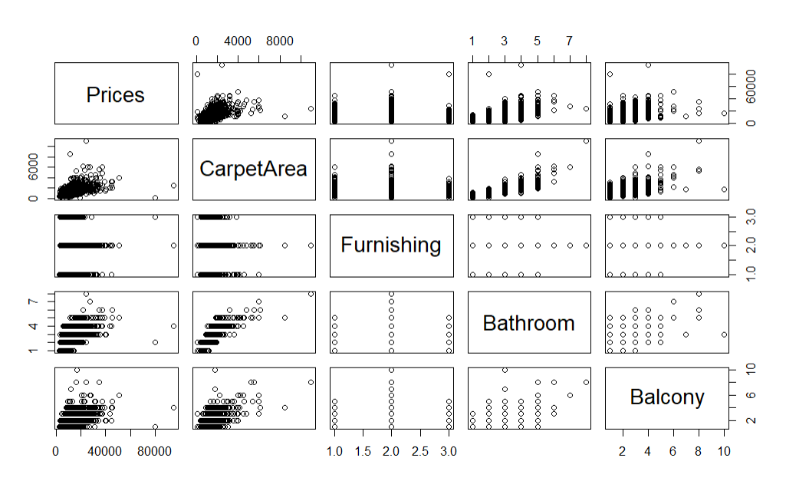
Plotting the data
Testing Variables
Once we narrowed down our data to just New-Delhi, we were able to see a pattern in the data between Pricing and Carpet Area.

Slide 10
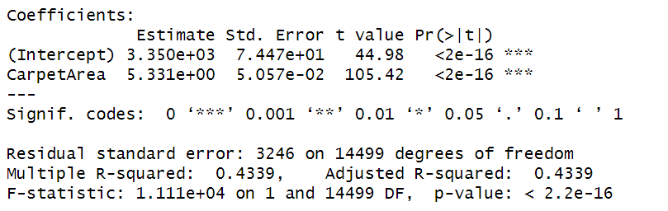
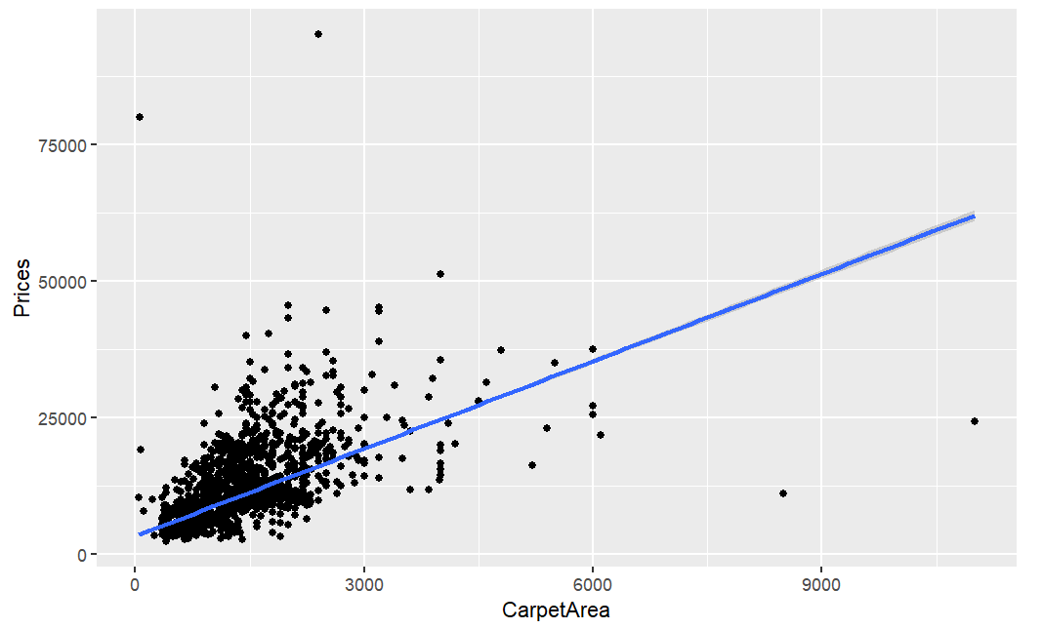
REGRESSION ANALYSIS for new delhi price vs carpet area
LINEAR MODEL
Our linear regression analysis tells us Carpet Area is a significant variable in predicting Housing Pricing in New-Delhi.
Model is statistically significant. 43% of the variation in Housing Pricing can be explained by Carpet Area.
Simple Linear Regression Formula:
  Pricing = 3,349 + 5.33CA

Slide 11
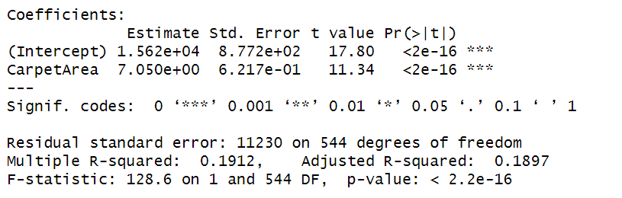
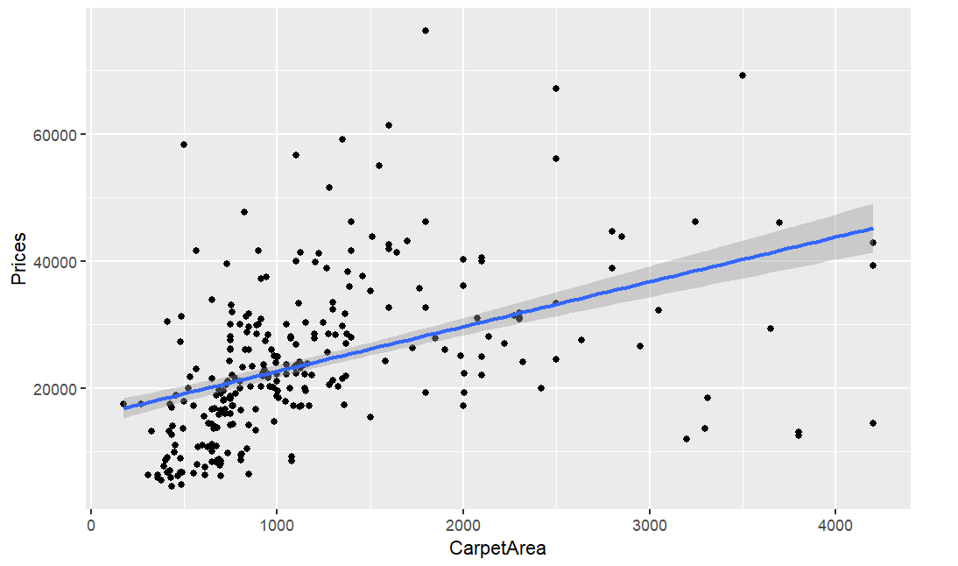
REGRESSION ANALYSIs for mumbai price vs carpet area
LINEAR MODEL
Our linear regression analysis tells us Carpet Area is a significant variable in predicting Housing Pricing in Mumbai.
19% of the variation in Housing Pricing can be explained by Carpet Area.
Simple Linear Regression Formula:
  Pricing = 15,615 + 7.05CA

Slide 12
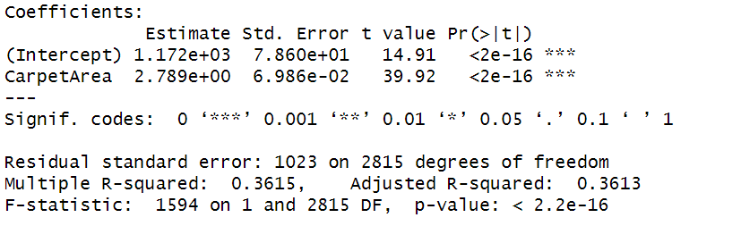
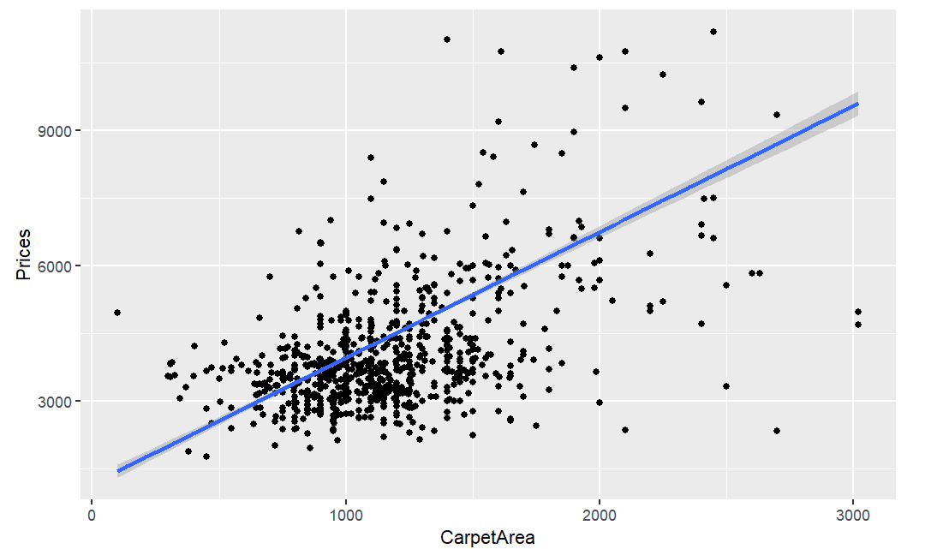
REGRESSION ANALYSIS for Jaipur price vs carpet area
LINEAR MODEL
Our linear regression analysis tells us Carpet Area is a significant variable in predicting Housing Pricing in Jaipur.
36% of the variation in Housing Pricing can be explained by Carpet Area.
Simple Linear Regression Formula:
  Pricing = 1,172 + 2.79CA

Slide 13
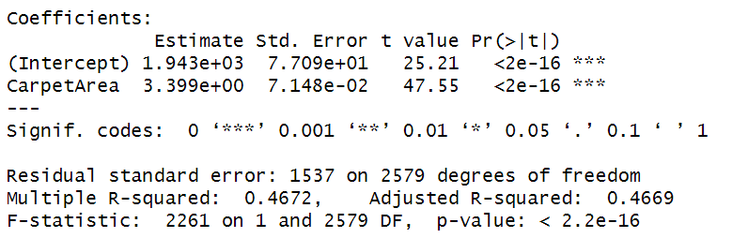
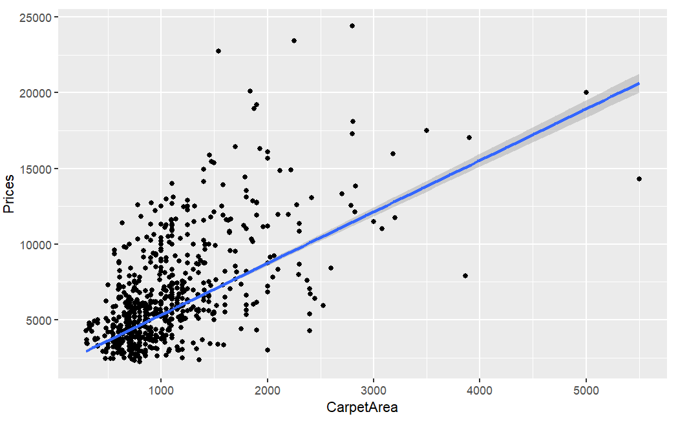
REGRESSION ANALYSIS for kolkata price vs carpet area
LINEAR MODEL
Our linear regression analysis tells us Carpet Area is a significant variable in predicting Housing Pricing in Kolkata.
47% of the variation in Housing Pricing can be explained by Carpet Area.
Simple Linear Regression Formula:
  Pricing = 1,943 + 3.39CA

Slide 14
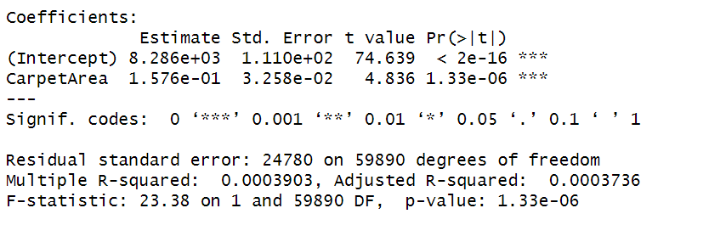
REGRESSION ANALYSIs for all cities price vs carpet area
LINEAR MODEL
Our linear regression analysis tells us Carpet Area is a significant variable in predicting Housing Pricing in all cities, but the Model is not statistically significant since the p-value is not less than .05.
If this model were statistically significant, only .03% of the variation in pricing can be explained by the variation in Carpet Area. This model has a poor overall fit when combining all the cities.

Slide 15
Summary of Statistical analysis
We can confidently say Carpet Area is a significant variable of housing pricing when analyzing larger cities individually.
Potential Reasons for Weak MLR:
  The relationship is indeed insignificant
  The larger data set could be causing a loss in degrees of freedom.
  Independent variables could be interacting with each other (multicollinearity)
  There are missing variables
If there was a further investigation into the data, our suggestion would be to potentially convert other categorical variables to numerical to test.
Notes:
This makes sense bc for ex. A large home in tenderloin vs a small home in nobb hill will be significantly different

Slide 16
BACKUP SLIDES

Slide 17
Project update 1
Accomplishments: We found a dataset with over 10,000 lines from Kaggle Our data is “House Prices” and we plan to advise buyers on features that are costly when purchasing a house Uploaded data into R with no issues Explored structure of data Variables: Price (Rupees), Location (city in India), Carpet Area (equivalent to square footage), Status, Floor (which floor in the building the house is for sale), Transaction (new property, resale, rental, other), Furnished (fully, semi, not furnished), Facing (direction the house faces), Overlook (garden, park, pool), Society, Bathrooms (number of bathrooms), Balcony (number of balconies), Parking (covered or not), Owners (current type of ownership of house), Super Area | What is working well for the team: Dataset meets requirements Structure of presentation would include information on the dataset and variables as well as structure of the data, results of this data, and a recommendation for a potential buyer in the housing market
Plans for the next update: Looking to have our presentation in Tableau as opposed to PowerPoint Need to understand how in-depth presentation should be (ex. # of slides) Need to convert Lakhs to Crores Drop columns with missing data (ex. Plot Area, Dimensions) | Issues: Pricing is in Rupees and not USD; need to convert to USD Cities where data was sampled are in India so this information would not be as applicable to U.S. buyers Many data points are missing Carpet Area/Square Footage Need to understand variable “Status” Need to understand variable “Society” Need to understand difference between “Carpet Area” vs “Super Area”
Only product specifically dedicated to the commercial market
AUTHENTIC
First beautifully designed building that's both stylish and functional

Slide 18
Project update 2
Accomplishments: Formatted and outlined our PPT Cleaned up our data – removed columns with no data, replaced N/As, converted to Crores | What is working well for the team: Meeting times
Plans for the next update: Run regression analysis Consolidate results Finalize PPT | Issues: Running data on Angela’s R Studio
Only product specifically dedicated to the commercial market
AUTHENTIC
First beautifully designed building that's both stylish and functional

Slide 19
Project update 3
Accomplishments: Converted variables to numerical Ran regression analysis Found significant variables Cleaned up Train and Test sets by removing NAs | What is working well for the team: Data is cleaned up and working well for the team Format of PPT is set
Plans for the next update: Test data with Rpart and SVM Summarize results and input into PPT | Issues: Error with confusionMatrix formula Need to ask Prof about finding summary of p-values for each variable; found a way to check each variable but consolidated view is not working
Only product specifically dedicated to the commercial market
AUTHENTIC
First beautifully designed building that's both stylish and functional

